Slide 1
STEEL DATA SQL CHALLENGE - 3
Challenge 3
Customer Insights
~Raveena Thakur

Slide 2
INTRODUCTION
As a Customer Insights Analyst for 'The General Store’.
We have to analyzed the following tables to find out crucial information about our customers to provide insights to the marketing team.
The case study consist of 5 Tables :
Customers
Orders
Product
Basket
Country

Slide 3
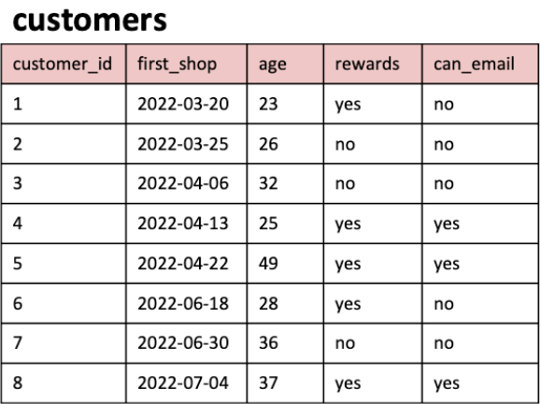
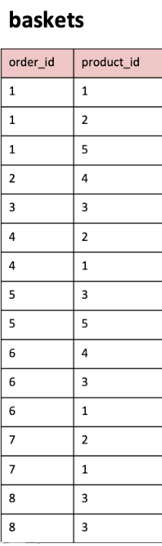
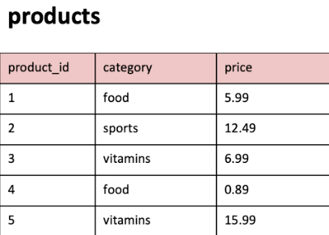
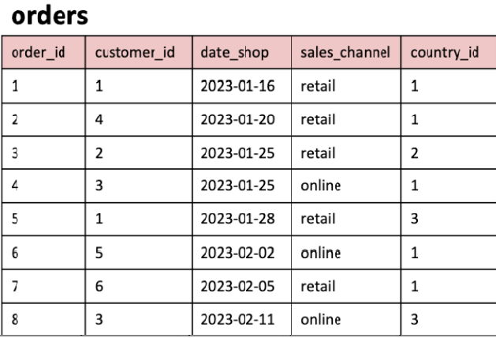
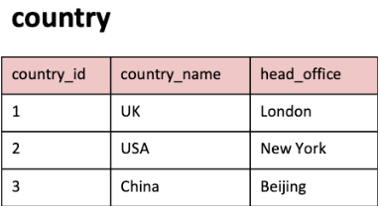
Table For Analysis

Slide 4





1. What are the names of all the countries in the country table?
2. What is the total number of customers in the customers table?
3. What is the average age of customers who can receive marketing emails (can email is set to 'yes')?

Slide 5
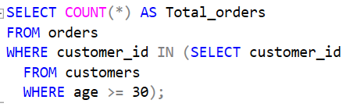

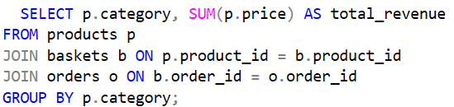

4. How many orders were made by customers aged 30 or older ?
5.What is the total revenue generated by each product category?

Slide 6




6. What is the average price of products in the 'food' category ?
7. How many orders were made in each sales channel (sales_channel column) in the orders table?

Slide 7
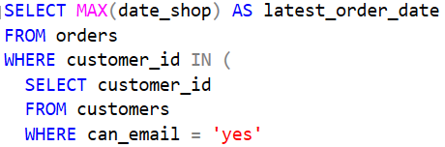

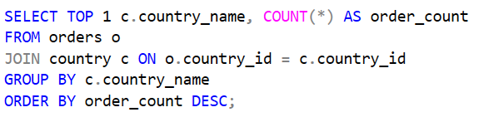

8. What is the date of the latest order made by a customer who can receive marketing emails?
9. What is the name of the country with the highest number of orders ??

Slide 8
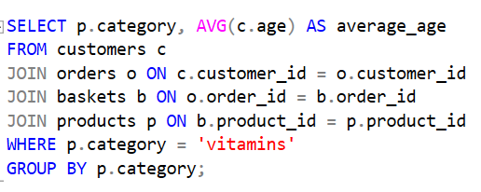

10. What is the average age of customers who made orders in the 'vitamins' product category?

